Slide 1
Introduction to ISO C++ STL.
By Mrinal Khemka

Slide 2
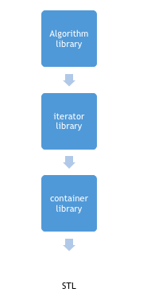
Standard Template Library
STL is an acronym for standard template library. It is a set of C++ template classes that provide generic classes and function that can be used to implement data structures and algorithms .STL is mainly composed of :
Algorithms
Containers
Iterators
STL provides numerous containers and algorithms which are very useful in comptetive programming , for example you can very easily define a linked list in a single statement by using list container of container library in STL , saving your time and effort.

Slide 3
Algorithm header in C++ STL
STL provide different types of algorithms that can be implemented upon any of the container with the help of iterators. Thus now we don’t have to define complex algorithm instead we just use the built in functions provided by the algorithm library in STL.
As already discussed earlier, algorithm functions provided by algorithm library works on the iterators, not on the containers. Thus one algorithm function can be used on any type of container.
Use of algorithms from STL saves time, effort, code and are very reliable.

Slide 4
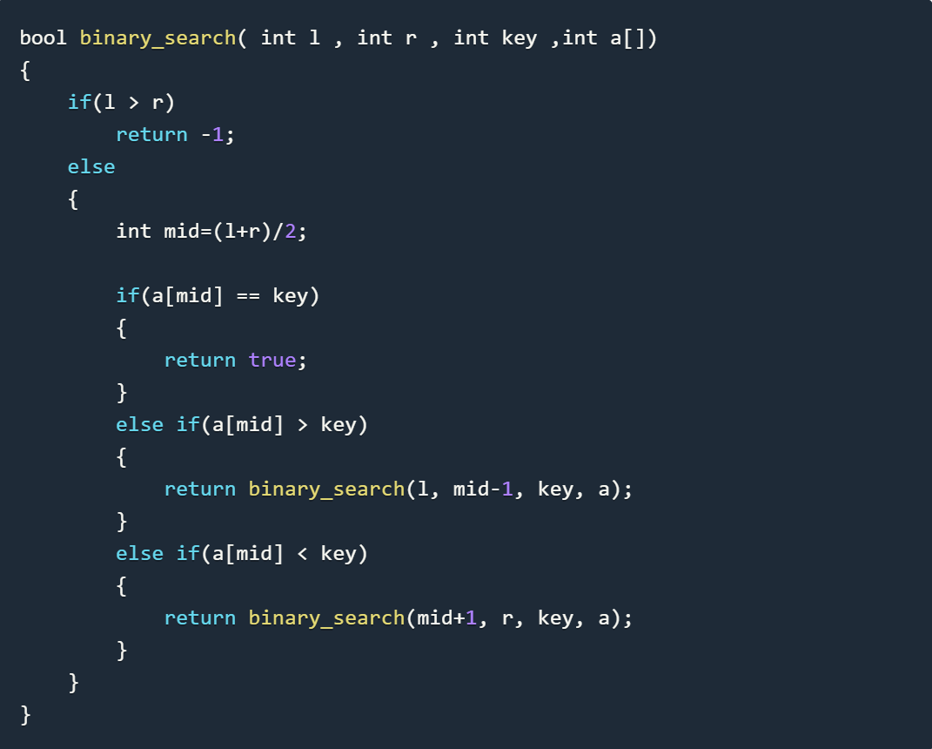
Binary Search Vs Binary Search in STL

Slide 5
Sort() in STL Partial_Sort()in STL
This function of the STL, sorts the contents of the given range. There are two version of sort() :
It sorts first half elements in the given range, the other half elements remain as they was initially.
1.sort(start_iterator, end_iterator ):sorts the range defined by iterators start_iterator
2. sort(start_iterator, end_iterator, compare_function):this also sorts the given range but you can define how the sorting should be done by compare_function.
partial_sort(start, middle, end ): sorts the range from start to end in such a way that the elements before middle are in ascending order and are the smallest elements in the range.
partial_sort(start, middle, end, compare_function):sorts the range from start to end in such a way that the elements before middle are sorted with the help of compare_function and are the smallest elements in the range.

Slide 6
upper_bound() and lower_bound() in STL.
rupper_bound()turns an iterator to the elements in the given range which does not compare greater than the given value. The range given should be already sorted for upper_bound() to work properly. In other words it returns an iterator to the upper bound of the given element in the given sorted range.
lower_bound():returns an iterator to the elements in the given range which does no compare less than the given value. The range given should be already sorted for lower_bound() to work properly. In other words it returns an iterator to the lower bound of the given element in the given sorted range.

Slide 7
Non Modifying Algorithms
Following are some non-modifying algorithms in Standard Template library that we will be covering:
count
equal
mismatch
search
search_n

Slide 8
Numeric Algorithms in C++ STL
These are some numeric algorithm defined inside STL
iota Method: iota(iterator first, iterator last, int value )
accumulate Method: accumulate(iterator first, iterator last, object_type result, binaryoperator op).
partial_sum Method:partial_sum(iterator first, iterator last, iterator result, binary_operation op)

Slide 9
Minimum and Maximum operations in STL
Following are the functions that we will be covering :
max Method
max_element Method
min Method
min_element Method
minmax Method
minmax_element Method

Slide 10
Containers in STL.
What are containers in STL?
Containers Library in STL gives us the Containers, which in simplest words, can be described as the objects used to contain data or rather collection of object. Containers help us to implement and replicate simple and complex data structures very easily like arrays, list, trees, associative arrays and many more.
The containers are implemented as generic class templates, means that a container can be used to hold different kind of objects and they are dynamic in nature!
Following are some common containers :
vector : replicates arrays
queue : replicates queues
stack : replicates stack
priority_queue : replicates heaps
list : replicates linked list
set : replicates trees
map : associative arrays

Slide 11
Vector containers in STL.
An array works fine when we have to implement sequential data structures like arrays, except it is static, i.e. we have to define its maximum size during its initialization and it cannot contain elements greater than its maximum size. Now suppose, if during the program execution we have to store elements more than its size, or if we are reading input stream of elements and we do not know the upper bound of the number of elements, there are high chances of occurrence of index_out_bound exception or unwanted termination of the program. An array works fine when we have to implement sequential data structures like arrays, except it is static, i.e. we have to define its maximum size during its initialization and it cannot contain elements greater than its maximum size. Now suppose, if during the program execution we have to store elements more than its size, or if we are reading input stream of elements and we do not know the upper bound of the number of elements, there are high chances of occurrence of index_out_bound exception or unwanted termination of the program.
Solution of the above problem is dynamic arrays! They have dynamic size, i.e. their size can change during runtime. Container library provides vectors to replicate dynamic arrays.

Slide 12
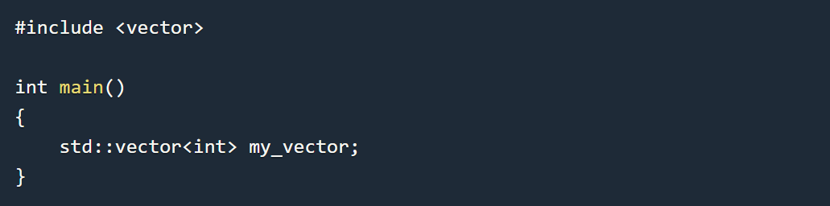
Vector Containers in STL.
Vector Syntax :

Slide 13
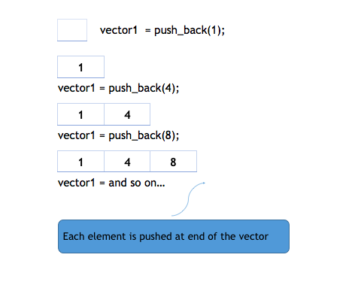
Member Functions of Vector STL.
push_back() function: It is used for inserting an element at the end of the vector. If the type of object passed as parameter in the push_back() is not same as that of the vector or is not interconvertible an exception is thrown..

Slide 14
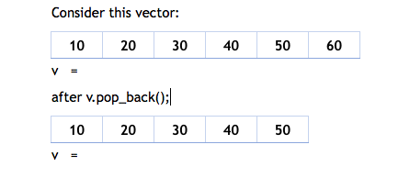
Member functions of Vector in STL.
insert() function:
insert(itr,element):method inserts the element in vector before the position pointed by iterator itr.
Overloaded functions for insert()
insert(itr,element,count)
insert(itr,v.begin(),v.end())
pop_back() function:
pop_back() is used to remove the last element from the vector. It reduces the size of the vector by one.
Below is an example :

Slide 15
Member function of Vector in STL.
erase()
resize()
swap()
clear()
size()
empty()
capacity()
at()
front() and back()

Slide 16
“There are only two kinds of languages: the ones people complain about and the ones nobody uses.”

Slide 17
Thank You

